Slide 1
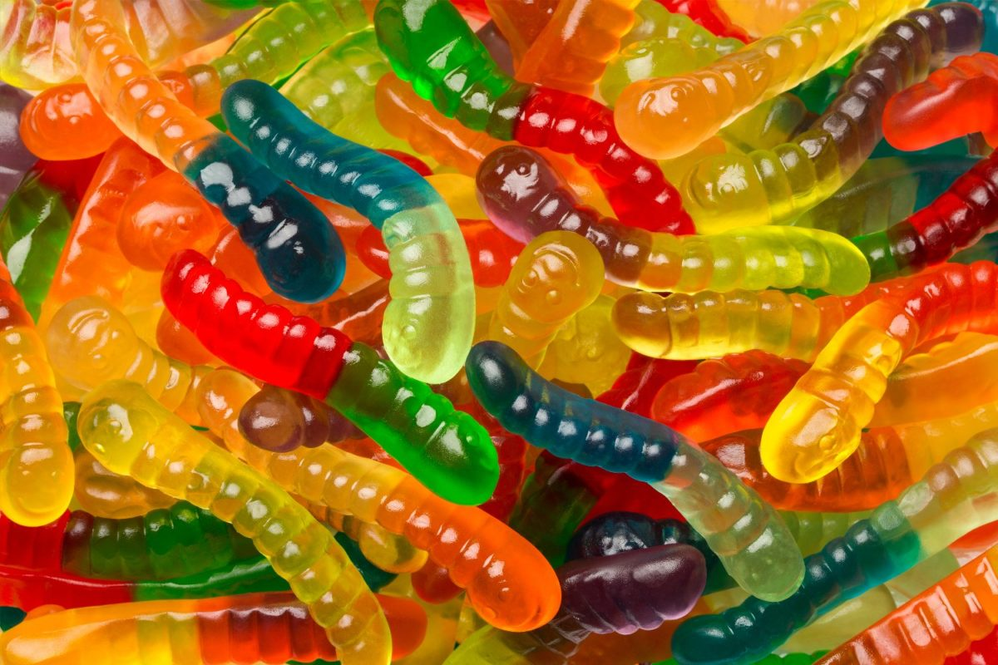
USING DATA
We will analyse and communicate data
Notes:
Insert cover image and use transparency settings to fade image.

Slide 2
Do not delete this slide.
This slide is designed so that you can copy the prompt box you need and insert it into your slides.
This slide is hidden and will not be included when presenting your lesson.
TRACK WITH ME
VOCABULARY
1 -
HINT
Students, remember….
CHECK FOR UNDERSTANDING
READ WITH ME
TEACHER CUE
MAKE THE CONNECTION
Students, you already know….
EXTENSION

Slide 3
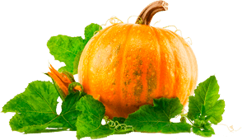
In this experiment, a scientist wanted to test what type of pumpkin plant grew the most pumpkins. They used 2 types of pumpkin plants (Kent and Field).
At the end of 4 months all the pumpkins on each plant were counted.
What the independent variable is?
What the dependent variable is?
What would be two controlled variables?

Slide 4
Repeat the opposite word/phrase.
LABORATORY
ROOM FOR SCIENCE

Slide 5
Repeat the opposite word/phrase.
SUMMARISE
WRITE THE MAIN IDEAS

Slide 6
Repeat the opposite word/phrase.
DEMONSTRATE
SHOW WITH ACTION

Slide 7
Repeat the opposite word/phrase.
NORM
WAY OF DOING THINGS

Slide 8
Repeat the opposite word/phrase.
SCIENTIFIC
TO DO WITH SCIENCE

Slide 9
We will analyse and communicate data
TRACK WITH ME
READ WITH ME
We will compare₁ qualitative and quantitative data
We will construct tables using data
We will calculate averages
DECLARE THE OBJECTIVE
Read the learning objective to your partner.
VOCABULARY
1 - Look at the differences
Notes:
Learning Objectives contain concepts (nouns, big ideas), skills (verbs, measurable behaviours) and sometimes context (restricting or targeting conditions).
●Example: Students will be able to describe the concept of density and apply it to floating and sinking.
●
Success criteria are specific measurable outcomes that if met mean that the student has met the learning objective.
Examples:
•Students will be able to compare densities of substances using mass and volume.
•Students will be able to identify whether a solid or liquid will float or sink in a liquid based on their densities.

Slide 10
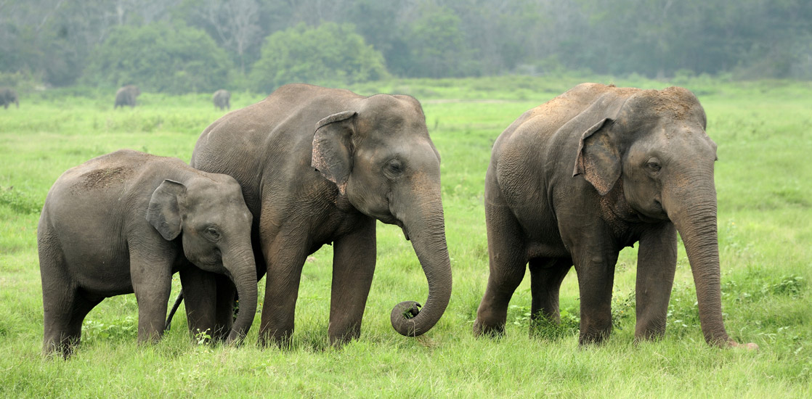
We will analyse and communicate data
End
1
2
3
4
5
6
7
8
9
10
11
12
13
14
15
16
17
18
19
20
21
22
23
24
25
26
27
28
29
30
TEACHER CUE
What is an observation?
Look carefully at the elephants in the above image and list the things you observe about them.

Slide 11
We will analyse and communicate data
An important skill for scientists is to make detailed observations and record them carefully.
There are two types of observation:
Qualitative observations
Quantitative observations
CHECK FOR UNDERSTANDING
What are the base words?

Slide 12
We will analyse and communicate data
Qualitative observations involve how things appear to your senses: what you see, hear, feel, smell or taste.
These are called qualities and include things like shape, colour, hardness, roughness and sweetness.
What are your qualitative observations of the elephants?
Example: The elephants are large and grey, and have rough, wrinkly skin.

Slide 13
We will analyse and communicate data
Quantitative observations involve counting or measuring the quantity of something.
They answer the questions "How many?" or "How much?", and always involve numbers as well as words.
What are your quantitative observations of the elephants?
Example: There are three elephants in this group. They each have four legs.

Slide 14
We will analyse and communicate data
Qualitative or quantitative?
The car was travelling at 100 km per hour.

Slide 15
We will analyse and communicate data
Qualitative or quantitative?
The chimpanzee learned how to use the tools very quickly.

Slide 16
We will analyse and communicate data
Qualitative or quantitative?
This pizza tastes delicious!

Slide 17
We will analyse and communicate data
Qualitative or quantitative?
Ms Alex’s voice is really loud

Slide 18
We will analyse and communicate data
Qualitative or quantitative?
Collingwood won the football match by 48 points

Slide 19
We will analyse and communicate data
Qualitative or quantitative?
The plant grew large purple flowers

Slide 20
We will analyse and communicate data
Qualitative or quantitative?
The beaker contained 40 mL of hydrochloric acid.

Slide 21
We will analyse and communicate data
Qualitative or quantitative?
The temperature of the room increased by 11°C

Slide 22
We will analyse and communicate data
Qualitative or quantitative?
Ms Alex is 187cm tall

Slide 23
We will analyse and communicate data
Qualitative or quantitative?
The students in year 7 are all 11 years old

Slide 24
We will analyse and communicate data
Qualitative or quantitative?
The SRC uniform is navy blue

Slide 25
We will analyse and communicate data
Qualitative or quantitative?
There are 32 students in this class

Slide 26
We will analyse and communicate data
Qualitative or quantitative?
The sky is filled with fluffy white clouds

Slide 27
We will analyse and communicate data
Qualitative or quantitative?
Ms Alex’s bottle is pink and holds 950mL of water

Slide 28

We will analyse and communicate data
Making observations is an important part of any scientific investigation. Every observation gives us pieces of information, called data.
There are two types of observation, so two different ways of collecting data.
CHECK FOR UNDERSTANDING
What is quantitative data? How would you display qualitative data?
If the data is quantitative, you can also make a graph. This makes it easy to:
make comparisons
see patterns and trends
communicate the results to other people

Slide 29
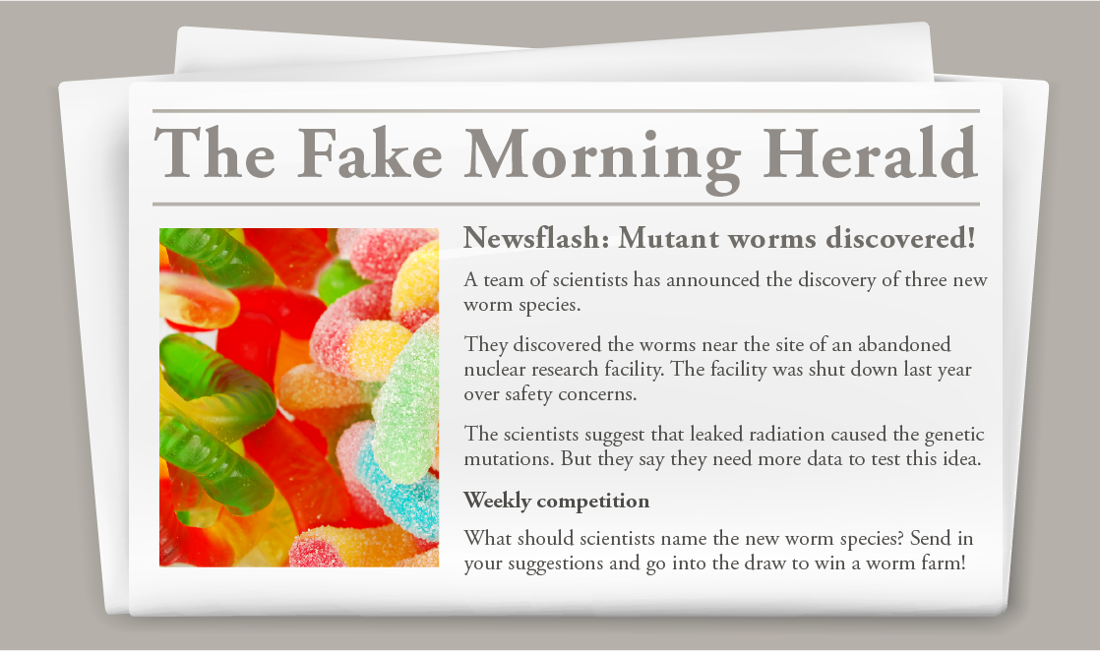
We will analyse and communicate data
Investigating worms
You have been given samples of the three worm species to investigate. You'll need to collect both qualitative and quantitative data so that you can compare the species.

Slide 30
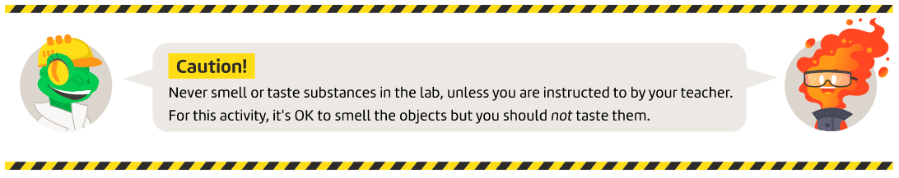
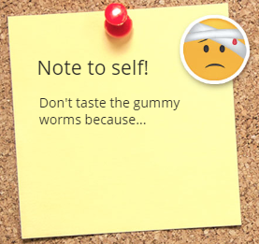
We will analyse and communicate data

Slide 31

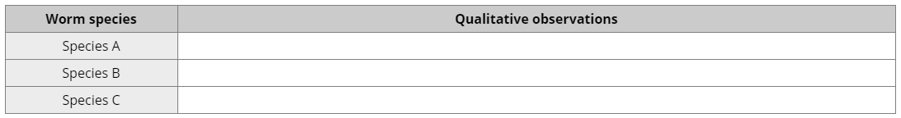
3 minutes
We will analyse and communicate data
Investigating worms- Qualitative
Describe your qualitative observations of each worm species in the table
What similarities between the three worm species can you observe?
What differences between the three worm species can you observe?
HINT
You can start by carefully observing their colour, shape, texture, hardness, smell...

Slide 32
We will analyse and communicate data
Investigating worms- Quantitative
Each group will need:
electronic mass balance
30 cm ruler
Calculator
We will measure the mass and length of each worm.
We will then need to calculate and average for each species.
HINT
Mass is the amount of matter in an object. In everyday life we call it “weight”.

Slide 33
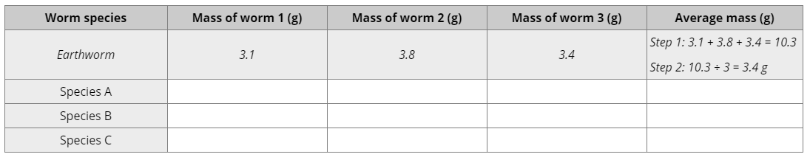
We will analyse and communicate data
Investigating worms- Quantitative
Measure and record the mass of each worm. Calculate the average mass for each species.
HINT
Mass is the amount of matter in an object. In everyday life we call it “weight”.

Slide 34
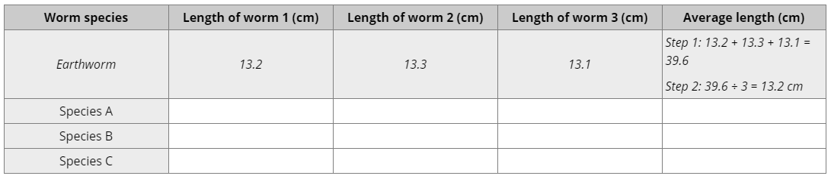
We will analyse and communicate data
Investigating worms- Quantitative
Measure and record the length of each worm. Calculate the average length for each species.
HINT
Make sure you are measuring from the first notch on the ruler

Slide 35
We will analyse and communicate data
Discussion
Can you draw a general conclusion about a whole worm species by observing only three worms?
Did different groups in the class calculate different average values (of either mass or length) for the same species?
What are the average values for the class as a whole? Are these likely to be more accurate than the values of just one group? Why?
How would the situation be different if you were a scientist studying real worms rather than gummy worms?

Slide 36
We will analyse and communicate data
TRACK WITH ME
READ WITH ME
We will compare₁ qualitative and quantitative data
We will construct tables using data
We will calculate averages
DECLARE THE OBJECTIVE
Read the learning objective to your partner.
VOCABULARY
1 - Look at the differences
Notes:
Learning Objectives contain concepts (nouns, big ideas), skills (verbs, measurable behaviours) and sometimes context (restricting or targeting conditions).
●Example: Students will be able to describe the concept of density and apply it to floating and sinking.
●
Success criteria are specific measurable outcomes that if met mean that the student has met the learning objective.
Examples:
•Students will be able to compare densities of substances using mass and volume.
•Students will be able to identify whether a solid or liquid will float or sink in a liquid based on their densities.

